Slide 1
LLVM for RISCV
Compiler

Slide 2
Research Problem Statement #1
Enhance the verifiability of code generated by RISCV compilers by proposing modifications to the compiler infrastructure and developing compiler optimizations for new customized instructions.
Objectives:
Develop a certified RISCV compiler using LLVM
Evaluation of certified RISCV compiler by implementing Transactional memory extension (T) in the architecture
Duration
3 years

Slide 3
Plans
Understand the LLVM compiler
Internals
Workflow
Tools involved
Existing frameworks
Create a LLVM setup locally
Run basic examples on it to flow-flush its understanding
Run existing supported RISCV instructions
Addition of new custom instruction to the compiler
Understand process for adding new custom instruction
Understand Transactional memory extension (T) support
Add Transactional memory extension (T) support
Test and validate it
Understand the performance optimization techniques
Apply those techniques to optimize the performance of newly added custom instruction

Slide 4
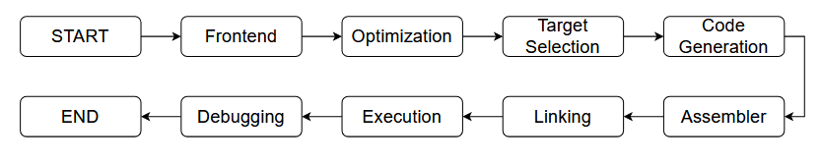
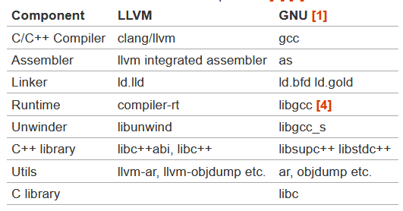
Workflow
Workflow
Toolchain component

Slide 5
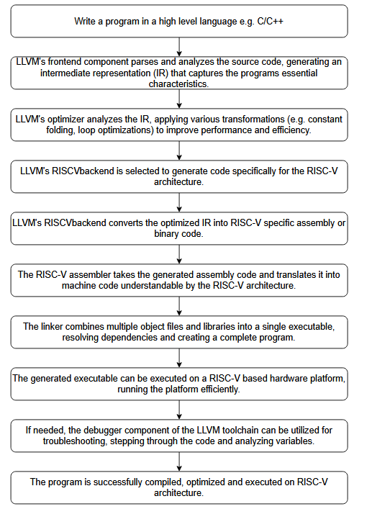
Workflow

Slide 6
LLVM RISC-V toolchain & components
Assembler
It translates human-readable assembly code into machine code that the RISC-V architecture can understand and execute.
Linker
It combines multiple object files and libraries into a single executable file, resolving dependencies and creating a complete program.
Debugger
It provides tools for finding and fixing issues in programs, allowing developers to step through code, inspect variables, and diagnose problems during development and testing.
Notes:
Overall, the LLVM RISC-V toolchain empowers developers to build efficient, portable, and reliable software for the RISC-V architecture, enhancing productivity and facilitating the growth of the RISC-V ecosystem.

Slide 7
Benefits of using LLVM and RISC-V toolchain for Software development
Portability:
It enables developers to write software for the RISC-V architecture, ensuring compatibility across different RISC-V-based platforms.
Efficiency:
The toolchain produces optimized machine code, enhancing the performance and resource utilization of RISC-V programs.
Productivity:
It provides essential tools for software development, enabling efficient debugging, testing, and optimization of RISC-V code.
Integration:
The toolchain seamlessly integrates with other LLVM components, allowing developers to leverage a comprehensive set of development tools and optimizations.
Ecosystem:
The LLVM RISC-V toolchain is part of a vibrant open-source ecosystem, offering community support, libraries, and resources for accelerated software development.

Slide 8
Identify atleast one use-case for RISC-V compiler optimization
Explore atleast one custom instruction with respect to RISC-V specification
Transactional memory extension (T)
Prepare a workflow for compiler upgradation for a custom instruction
Develop knowledge base on certification of compilers by citing some examples
Compcert

Slide 9
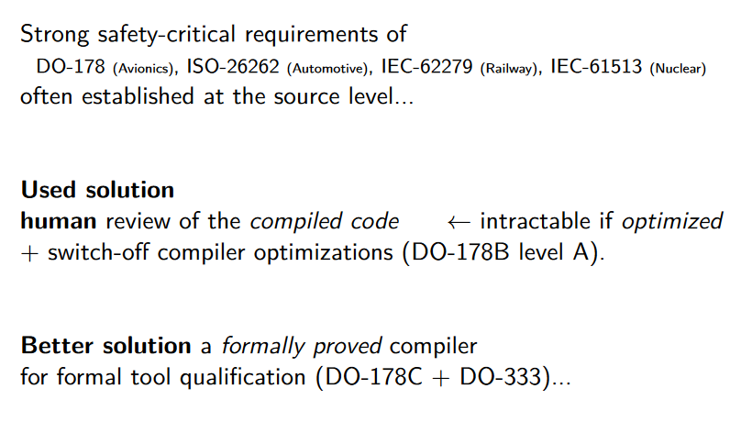
Certified ( = formally proved) Compiler

Slide 10
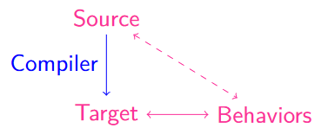
Certified ( = formally proved) Compiler
Compiler correctness reduced to that of its formal spec.
Advantages of formal spec over compiler code
Closer to informal spec (e.g. simpler for human reviews)
More compositional (e.g. for simpler tests)
Another benefit : Traceability
Formal proof = computer-aided review of the compiler code w.r.t its spec
Diagrammatic view
of the correctness

